Slide 1
THE WINDOWS OPERATING SYSTEM
Whenever a new computer is purchased, an operating system has to be installed on the Computer before the Computer can be used.
One of the most popular operating system is the Windows.
The operating system is a software package that enables you to communicate with your computer by way of running application programs.
There are different versions of the Windows such as Windows 98, Windows 2000, Windows XP, Windows Vista, Windows 7, Windows 8, Windows 8.1 Windows 10 etc.
Department of Computer Science, KNUST-
Kumasi

Slide 2
Windows as an Operating System
Unlike Disk Operating System (DOS) that allows you to run a single application at a time, the Windows operating system has multitasking capabilities, meaning that it can run several application programs at the same time.
For the purpose of this course we will consider Windows 10 as it is more popular than the other versions. Every operating system must be able to perform the following functions.
Department of Computer Science, KNUST-
Kumasi

Slide 3
THE WINDOWS 10 DESKTOP
Sometimes abbreviated as Win10, Microsoft Windows 10 is the latest version of Microsoft Windows and was released on July 29, 2015. Windows 10 is an upgrade to Windows 8.1.
All the different versions of Windows use a desktop for the standard interface.
Think of the desktop as workspaces where you can access everything that is on your computer.
For example, using your desktop it is possible to access your disk drive, run an application program, access the internet, change your computer settings, etc.
The desktop contains three main items namely the Start Button, the Taskbar and Icons.
Department of Computer Science, KNUST-
Kumasi

Slide 4
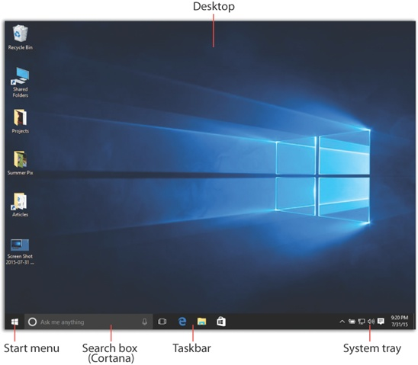
THE WINDOWS 10 DESKTOP
Department of Computer Science, KNUST-
Kumasi

Slide 5
THE WINDOWS 10 DESKTOP Start Menu
The word “Start” doesn’t actually appear on the Start menu, as it did for years; now the Start menu is just a square button in the lower-left corner of your screen, bearing the Windows logo
But it’s still called the Start menu, and it’s still the gateway to everything on the PC.
Whenever the start button is clicked, it gives you the option of running a program, logging off so that another user can use the Computer and turning your computer off when you no longer wants to use it.
Department of Computer Science, KNUST-
Kumasi

Slide 6
THE WINDOWS 10 DESKTOP Start Menu
Also, any application program that does not have a shortcut on the desktop can only be run by first clicking at the start and then selecting the appropriate options.
Department of Computer Science, KNUST-
Kumasi

Slide 7
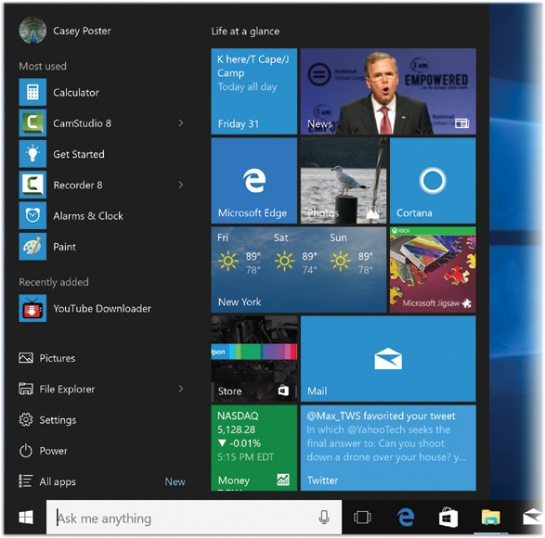
THE WINDOWS 10 DESKTOP Start Menu
The Start menu is split into two columns.
For convenience, let’s call them The Left Side and The Right Side.
Department of Computer Science, KNUST-
Kumasi

Slide 8
Start Menu: The Left Side
The left side is meant to be managed and run entirely by Windows itself.
With the left column showing pinned, recently and most-used apps.
You also get a power button at the top for options such as Hibernate, Standby and Shutdown, and an all apps option
Department of Computer Science, KNUST-
Kumasi

Slide 9
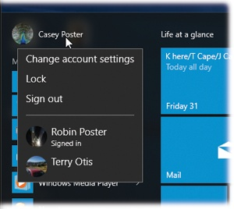
Start Menu: The Left Side
Your account icon isn’t just an icon; it’s also a pop-up menu. Click it to see the “Sign out” and “Lock” commands, as well as a shortcut to your account settings.
Department of Computer Science, KNUST-
Kumasi

Slide 10
Start Menu: The Right Side
The right column features a selection of live tiles that you can customize, resize and reorganize. Not only that, but the search field at the bottom will look up related Internet results in addition to programs and files.
Department of Computer Science, KNUST-
Kumasi

Slide 11
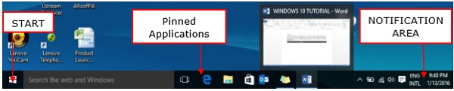
WINDOWS 10 TASKBAR
The Windows 10 taskbar sits at the bottom of the screen giving the user access to the Start Menu, as well as the icons of frequently used applications.
The Taskbar features the Notification Area which informs the user of different things like the state of the Internet connection or the charge of the laptop battery.
The icons in the middle of the Taskbar are “pinned” applications, which is a way to have a quick access to applications you use frequently. “Pinned” applications will stay in the Taskbar until you “unpin” them.
Department of Computer Science, KNUST-
Kumasi

Slide 12
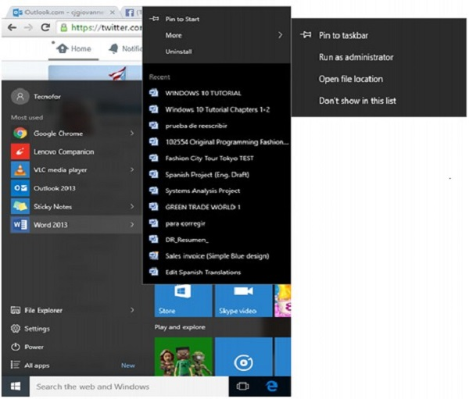
Pin an Application to the Taskbar
Step 1 - Search for the application you want to pin in the Start Menu.
Step 2 − Right-click on the application.
Step 3 − Select “More” option at the top of the menu.
Step 4 − Select the “Pin to taskbar” option.
Department of Computer Science, KNUST-
Kumasi

Slide 13
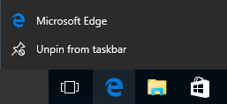
Unpin an Application to the Taskbar
To “unpin” it, just right-click the icon in the Taskbar .
Select “Unpin from taskbar”.
You can “pin” it back again any time you want.
Department of Computer Science, KNUST-
Kumasi

Slide 14
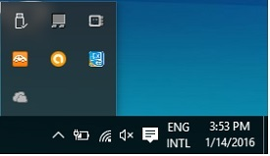
Notification Area
The Notification Area is located at the right side of the Taskbar.
It shows different types of notifications from your computer like your Internet connection, or the volume level.
Department of Computer Science, KNUST-
Kumasi

Slide 15
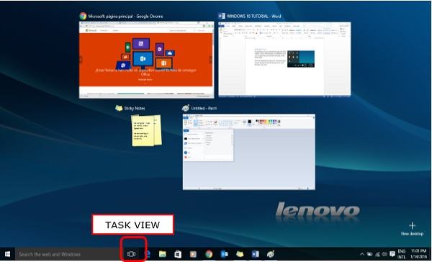
Task View
Task View allows you to quickly move within your open windows and applications. You can access it by clicking the “Task View” button from the Taskbar.
Department of Computer Science, KNUST-
Kumasi

Slide 16
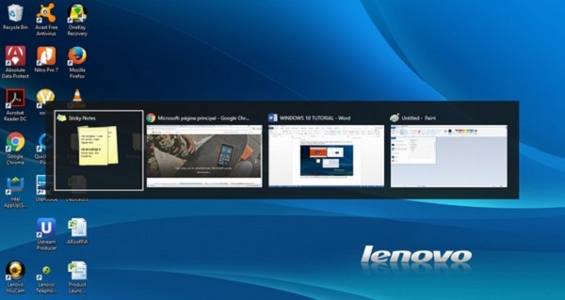
Task View
By pressing the Alt+Tab keyboard shortcut also serves a similar purpose
Department of Computer Science, KNUST-
Kumasi

Slide 17
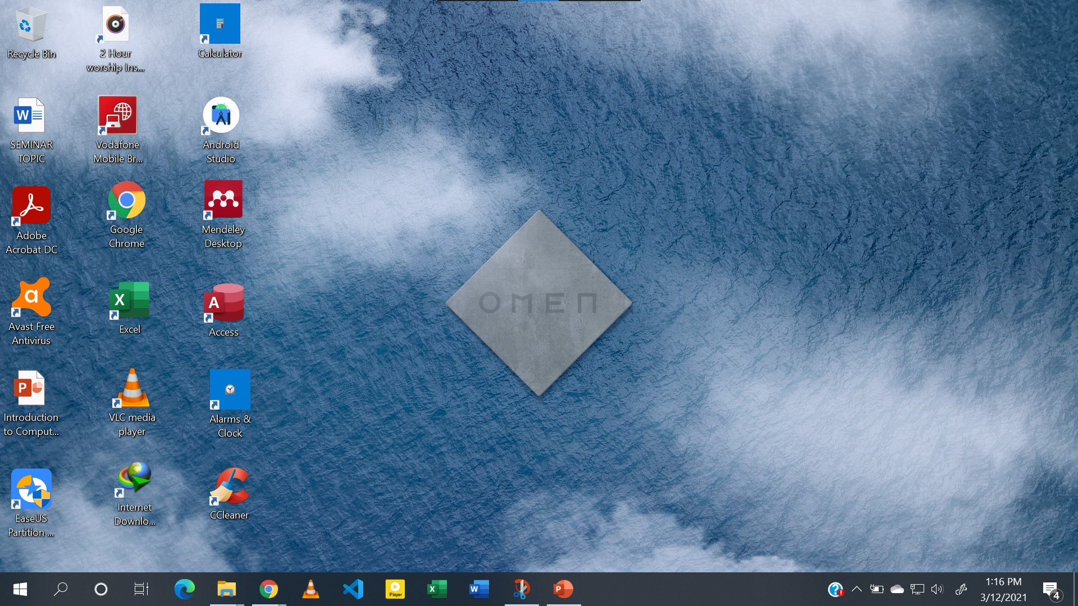
Icons
These are normally small graphical images or pictures that represent applications, files, and other parts of the operating system.
Department of Computer Science, KNUST-
Kumasi

Slide 18
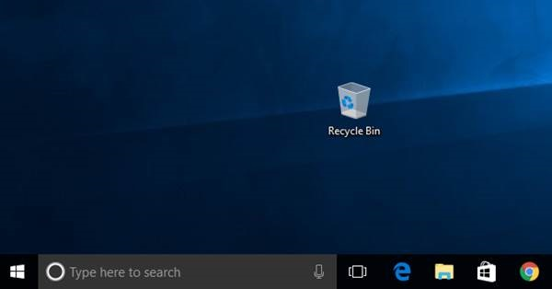
Icons
For example, one of such icons is the Recycle Bin where all files that are deleted are temporary stored, another is my Computer which makes it possible to access information on the different drives of your computer.
Department of Computer Science, KNUST-
Kumasi

Slide 19
Icons
Some of the icons are for objects. Object icons allow you to open programs and files. Examples of object icons include My Computer, Recycle Bin, and Internet Explorer.
Non object icons are normally shortcut icons and these allow you to run application programs or open files quickly.
The shortcut icons are those with little arrow in the left corner.
Adding or deleting an icon does not affect the programs on your computer but just the link.
Department of Computer Science, KNUST-
Kumasi

Slide 20
Opening a program using an icon
There are many ways that one can run a program. If the program has an icon, then its best to open the program using its icon.
To do this;
Place your mouse over the icon of the program you intend to open.
Then, double-click the icon.
Department of Computer Science, KNUST-
Kumasi

Slide 21
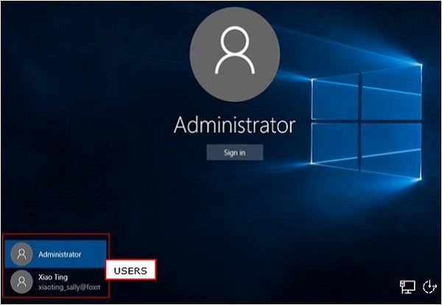
User Management (Switching Users)
Windows 10 allows you to log in to different user accounts when using your computer. You can choose which account you want to log in to after turning on the computer.
Department of Computer Science, KNUST-
Kumasi

Slide 22
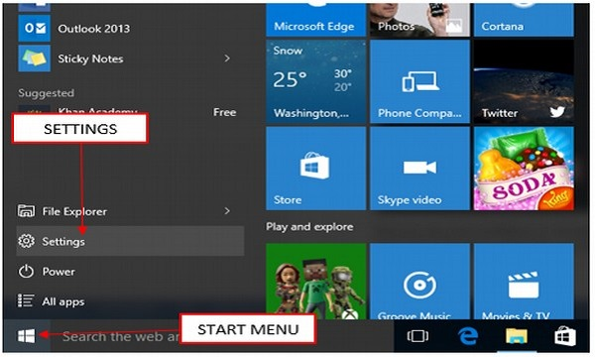
User Management (Switching Users)
But you can also configure or manage your user account after you’re logged in.
To do this,
Step 1 − Open the Start Menu.
Step 2 − Click on Settings.
Department of Computer Science, KNUST-
Kumasi

Slide 23
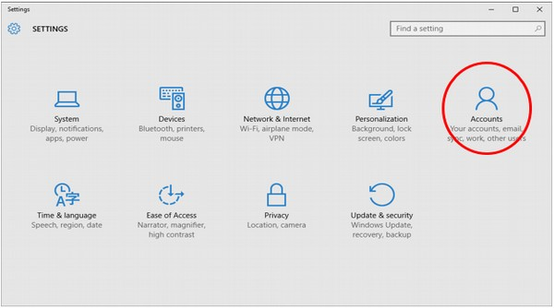
User Management(Switching Users)
Step 3
From the SETTINGS window, choose Accounts option.
Department of Computer Science, KNUST-
Kumasi

Slide 24
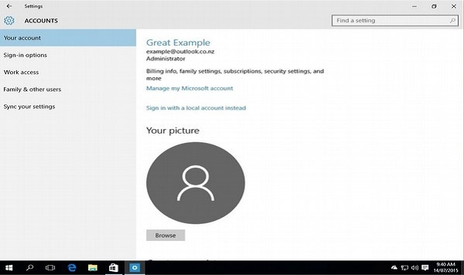
User Management(Switching Users)
Step 4
In the ACCOUNTS window, choose the account setting you want to configure.
Department of Computer Science, KNUST-
Kumasi

Slide 25
User Management(Switching Users)
Switch User allows someone else to log on to the computer. If you choose to Switch User, your applications will continue to run in the background while the new user logs on.
If you choose Log Off, your applications will close and you will have to log on and run your applications again if you have to do so.
Department of Computer Science, KNUST-
Kumasi

Slide 26
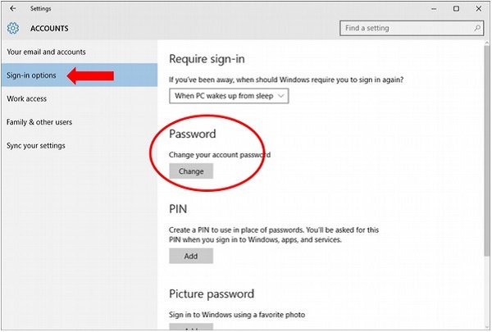
User Management(Switching Users)
If you want to change your sign-in options, like your password, select Sign-in options.
Under Sign-in options, Windows 10 lets you change your password.
It also lets you choose when the computer will ask you to sign in.
Department of Computer Science, KNUST-
Kumasi

Slide 27
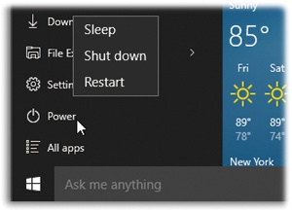
The Sleep/Shut Down/Restart Commands
Sleep
You can send a laptop to sleep just by closing the lid.
On any kind of computer, you can trigger Sleep by choosing it from the windows →Power command,
Or by pushing the PC’s power button
Department of Computer Science, KNUST-
Kumasi

Slide 28
The Sleep/Shut Down/Restart Commands
Restart
This command quits all open programs and then quits and restarts Windows again automatically.
The computer doesn’t actually turn off. You might do this to “refresh” your computer when you notice that it’s responding sluggishly.
Department of Computer Science, KNUST-
Kumasi

Slide 29
The Sleep/Shut Down/Restart Commands
Shut down
When you shut down your PC, Windows quits all open programs, offers you the opportunity to save any unsaved documents, exits Windows, and turns off the computer.
Department of Computer Science, KNUST-
Kumasi

Slide 30
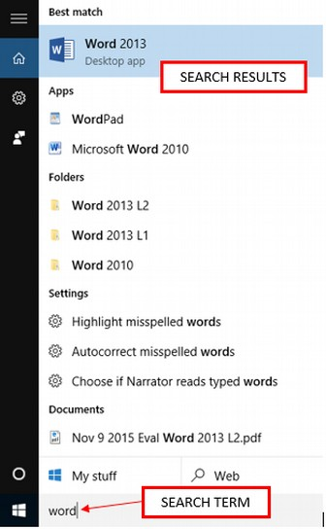
Applications (Running Programs)
Windows 10 lets you access your applications in several ways.
The easiest way is to search for the name of application using the Search box in Taskbar.
Department of Computer Science, KNUST-
Kumasi

Slide 31
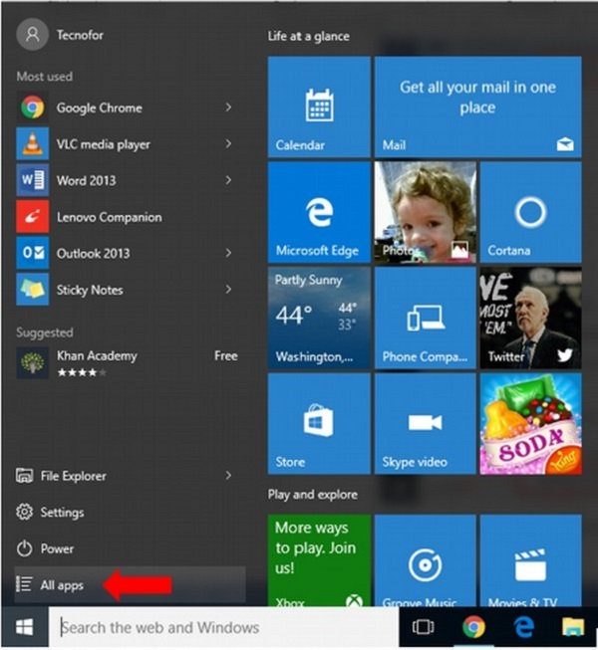
Applications (Running Programs)
Another basic option is to open the Start Menu and click on All Apps
Department of Computer Science, KNUST-
Kumasi

Slide 32
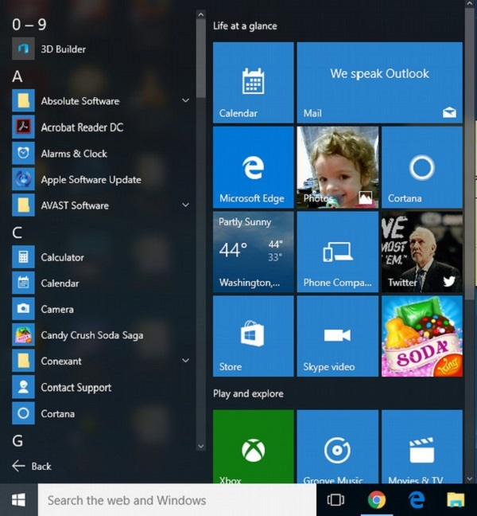
Applications (Running Programs)
After selecting All Apps, Windows 10 will present an alphabetical list of all the applications installed in your computer.
Department of Computer Science, KNUST-
Kumasi

Slide 33
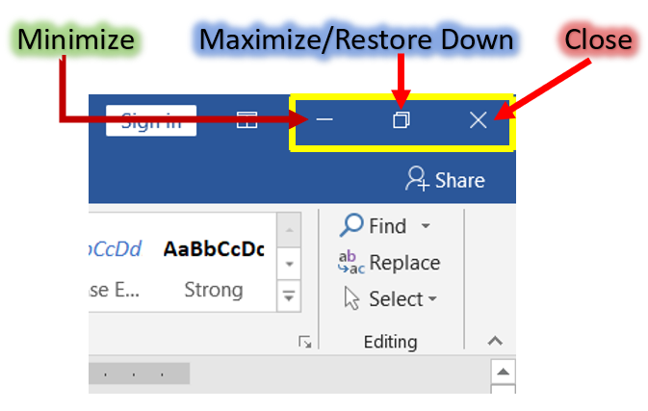
Minimizing, Maximizing, and Restoring Windows
Department of Computer Science, KNUST-
Kumasi

Slide 34
Minimizing, Maximizing, and Restoring Windows
The Minimize button shrinks the window and places it on the taskbar while leaving the program running at the background.
The Maximize button which is to the immediate right of the minimize button, looks like a small window, It is used to enlarge a window to cover the entire desktop (screen).
After a window is maximized, the Maximize button changes to the Restore button.
Department of Computer Science, KNUST-
Kumasi

Slide 35
Minimizing, Maximizing, and Restoring Windows
If you click the Restore button, the maximized window shrinks to its previous size (the size it was before you maximized it).
Note that when a window is maximized, you can double click the title bar to restore the window to its previous size and if you double click again the window will be maximized.
Department of Computer Science, KNUST-
Kumasi

Slide 36
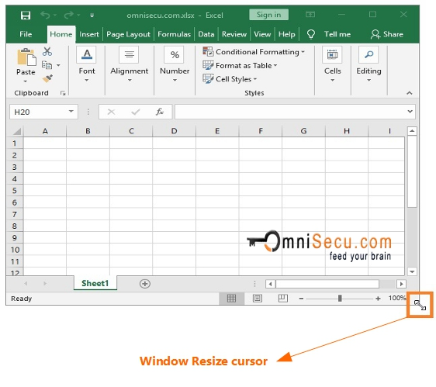
SIZING WINDOWS
Department of Computer Science, KNUST-
Kumasi

Slide 37
SIZING WINDOWS
To resize a window
Move the mouse pointer over any corner or border of the window.
The mouse pointer changes into a double-headed arrow pointing either up and down.
left and right, or diagonal if the mouse pointer is move over the bottom or top, left or right, or a corner respectively.
You should always make sure that the mouse pointer changes to a double-headed arrow before you proceed to the next step.
Click and hold down the left mouse button.
Department of Computer Science, KNUST-
Kumasi

Slide 38
SIZING WINDOWS
Drag the double-headed arrow out or in to make the window larger or smaller.
Release the mouse button when the window is the size you want.
Alternatively, you can also resize a window by the following method:
Right click any blank area of the title bar.
Select move from the menu options.
Press either the Up or Down arrow key of your keyboard if you want the window to be longer or shorter.
Department of Computer Science, KNUST-
Kumasi

Slide 39
SIZING WINDOWS
You are to press the left or the right arrow key if you want the window to be wider or narrower.
This locks the one side of the window to the mouse pointer such that as the mouse pointer is moved around the window resize.
Click the left button of the mouse when the desired size is obtained.
Before clicking at the left mouse button, you can press the escape (Esc) key if you change your mind on resizing so as to return your window to its initial size.
Department of Computer Science, KNUST-
Kumasi

Slide 40
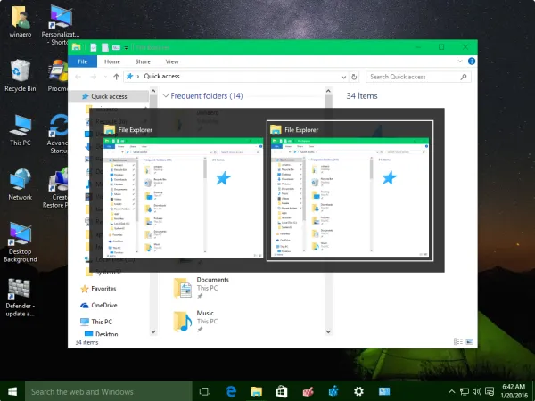
Moving a Window(File Explorer)
Department of Computer Science, KNUST-
Kumasi

Slide 41
Moving a Window(File Explorer)
Sometimes one window may obscure another window or an item you want to click on or view.
For example, if you open two windows (of two disk drives) and you want to copy a file from one window to the other, it will be easy if the two windows can be seen at the same time.
Therefore, if one of the windows is overlapping on the other window then one or more of the windows must be moved so that all windows can be see at the same time.
Department of Computer Science, KNUST-
Kumasi

Slide 42
Moving a Window(File Explorer)
To move a window,
Place the mouse pointer over the title bar (at the top of the window).
Click and hold down the left mouse button. (Note that you cannot move a window that has been maximized)
Drag the window to the place where you want it and release the mouse button.
Alternatively,
you can also move a window by the following method:
Right click at any blank area of the title bar
Department of Computer Science, KNUST-
Kumasi

Slide 43
Moving a Window(File Explorer)
Select move from the menu options
Press any of the cursor control movement (arrow) keys of your keyboard to lock the window to the mouse pointer.
Simply move the mouse pointer where you want the window to be. Note that as you move the mouse pointer anywhere on the desktop the window to be moved moves accordingly.
Click the left button of the mouse when the desired position is obtained.
Department of Computer Science, KNUST-
Kumasi

Slide 44
Moving a Window(File Explorer)
Before clicking at the left mouse button, you can press the escape (Esc) key if you change your mind on moving the window so as to return your window to its initial position.
Department of Computer Science, KNUST-
Kumasi

Slide 45
Switching Between Windows
Windows 10 allows you to have more than one program or window opened at the same time so that you can easily move between open windows if the need be.
The window you select becomes the active window. To know that a window is active on the desktop, its title bar color becomes deep .
When a window is inactive, the title bar color becomes light.
Department of Computer Science, KNUST-
Kumasi

Slide 46
Switching Between Windows
To switch between windows you will have to
Open all the required windows.
Size the windows, if necessary, so they are open on the desktop.
Click on any part of the window you want to work with and this will make the window the active one.
To make a different window the active one simple repeat the third step above.
Department of Computer Science, KNUST-
Kumasi

Slide 47
Switching Between Windows
To switch between windows you will have to
Simple click the required program/window button on the taskbar to activate the window you want to
Department of Computer Science, KNUST-
Kumasi
Department of Computer Science, KNUST-
Kumasi

Slide 48
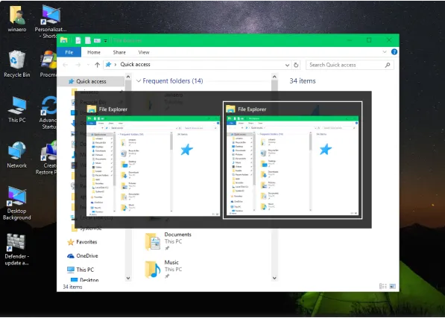
Switching Between Windows Using Keyboard
Switch to the desired window using Alt + Tab.
Department of Computer Science, KNUST-
Kumasi

Slide 49
More Windows 10 Bars and Buttons
The Title bar is the topmost bar and has the name of the application and icon. It contains buttons such as minimize, maximize/restore, close, etc.
The Title Bar
Department of Computer Science, KNUST-
Kumasi

Slide 50
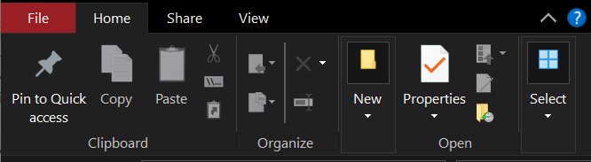
More Windows 10 Bars and Buttons
The Menu bar is a very important bar which contains most of the commands there a window holds. It is the bar that lies below the title bar.
The Menu Bar
Department of Computer Science, KNUST-
Kumasi

Slide 51
More on The Menu Bar
The menu bar has several grouping of commands. The largest group and common one is called Tab. So the tabs includes the File, Home, View, Insert, etc.
The next group is called Ribbons; it consists of related commands. An example is the Clipboard Ribbon which encapsulates all commands related to clipboard, such as copy, paste, cut etc.
NB: Many Ribbons make a Tab, and many related commands make a Ribbon
Department of Computer Science, KNUST-
Kumasi

Slide 52
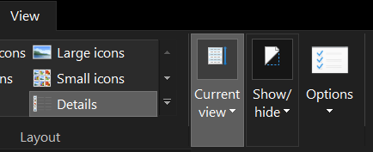
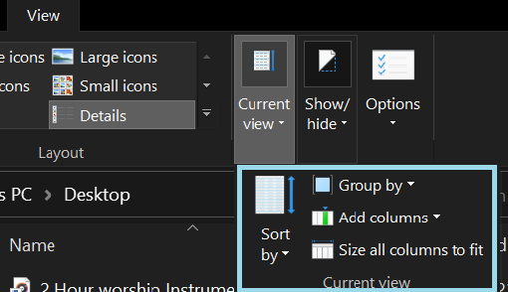
More Windows 10 Bars and Buttons
Choosing a menu option followed by an arrow head displays another set of menu options to choose from.
Current View is click in Fig. 1, and a dropdown menu appears as in Fig. 2
Fig. 1
Fig. 2
Department of Computer Science, KNUST-
Kumasi

Slide 53
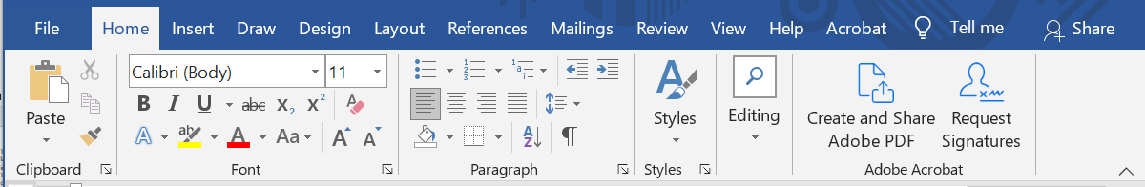
More Windows 10 Bars and Buttons
Some Windows 10 programs (such as Microsoft Word have toolbars across the top of the window.
The toolbar buttons allow you to print, cut, paste, or do other tasks.
The options vary depending on the program.
Microsoft Word Toolbar
Department of Computer Science, KNUST-
Kumasi

Slide 54
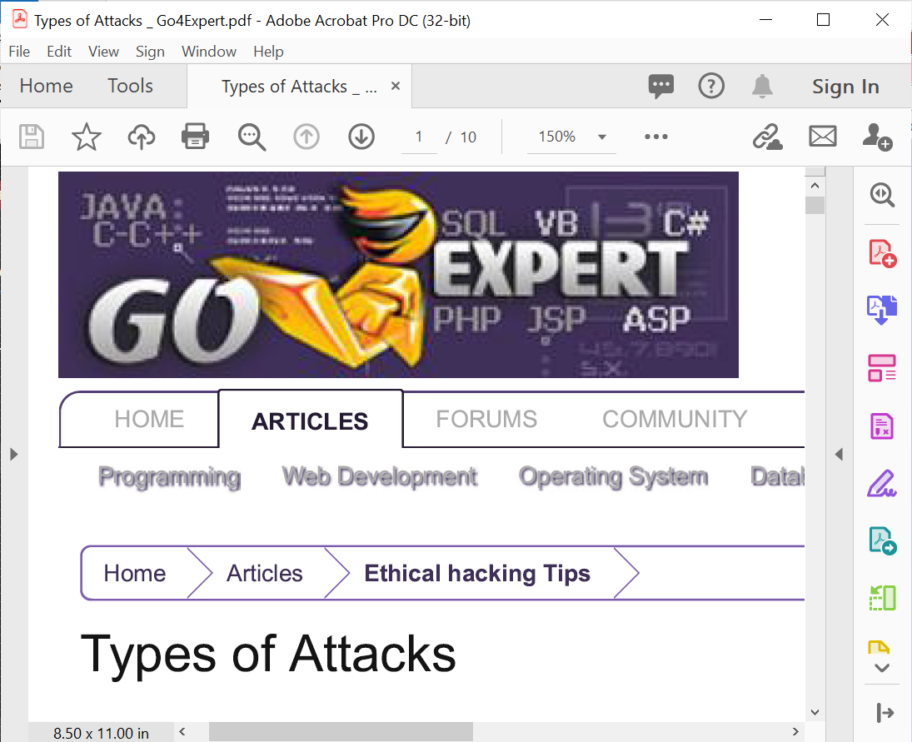
Scrolling
Vertical Scrollbar
Horizonal Scrollbar
Window showing the Vertical & Horizontal Scroll Bar
Department of Computer Science, KNUST-
Kumasi

Slide 55
Scrolling
Whenever for a particular window, one cannot see all the information within the window at the same time, Windows displays the scroll bar at the right side or the bottom of a window.
This is to make it possible for you view the hidden information by either moving the vertical scrollbar up or down, or by moving the horizontal scroll bar left or right depending on where the hidden information is.
It is especially convenient when viewing a long document.
Department of Computer Science, KNUST-
Kumasi

Slide 56
Scrolling
arrow to scroll up. arrow to scroll down.
arrows to scroll up one page at a time. arrows to scroll down one page at a time.
To scroll,
Click the
Click the
Click the
Click the
OR
Click and drag the scroll bars to view your document.
Department of Computer Science, KNUST-
Kumasi

Slide 57
The Control Panel
The Control Panel provides a number of tools that helps you to
customize the appearance and functionalities
add and remove programs to/from your computer
set up your network
and also to create or remove user accounts.
It also provides a means to ‘troubleshoot’ your
computer for problems and their solutions
Etc.
Department of Computer Science, KNUST-
Kumasi

Slide 58
To do any of the functions mentioned above, you will have to
Click Start.
Type Control Panel to search in Start menu. OR
Type Control Panel in the Search box (Cortana) of the taskbar.
In Windows 10, there are three different views of the control panel namely
the category view
small icons view and
large icons view
as shown on the next slide
Department of Computer Science, KNUST-
Kumasi

Slide 59
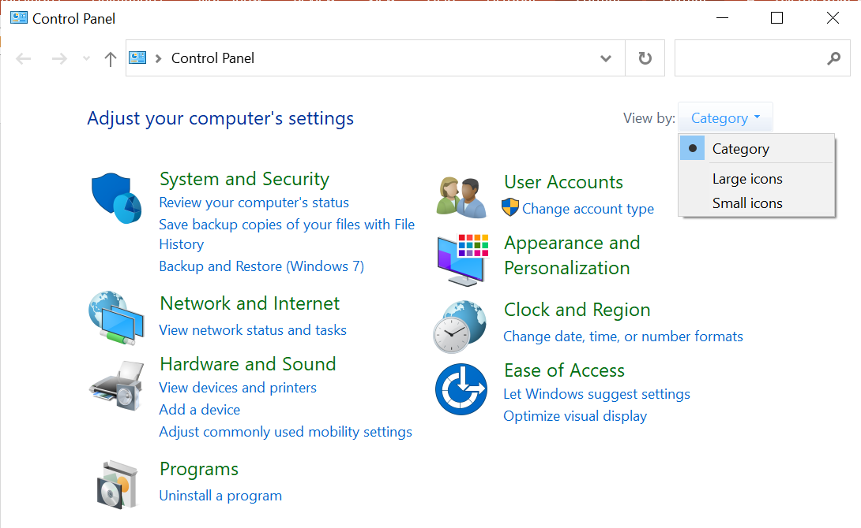
Category View of Control Panel
Department of Computer Science, KNUST-
Kumasi

Slide 60
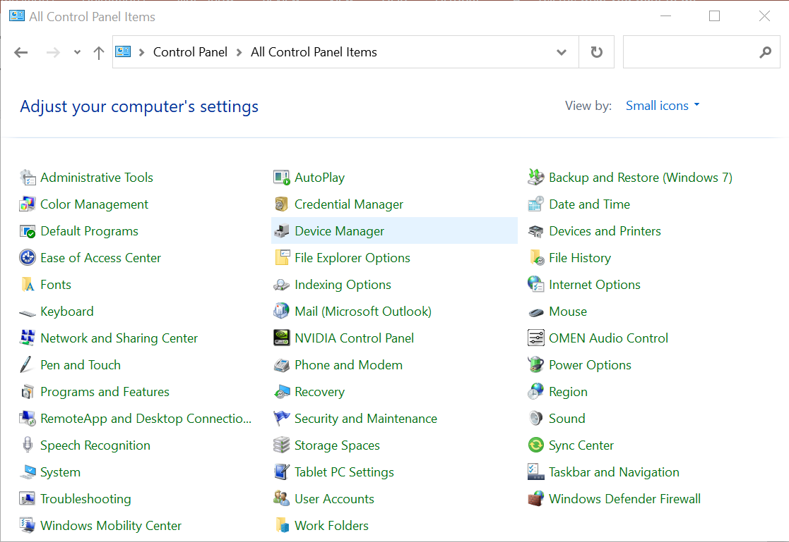
Small Icon View
Department of Computer Science, KNUST-
Kumasi

Slide 61
If the view is Icons,
the window presents a List of Tasks and related Control Panel icons.
If the view is category, then
windows present the categories to which the list of tasks belongs to.
Task and Control Panel icons perform basically the same functions.
If you look at the left side of the window, you will notice that the See Also and Troubleshooters dialog boxes provides several more related options.
To switch to any view simply look at the top right hand side of your current window and you will see View By: Click the arrow head, and select the option you want.
Department of Computer Science, KNUST-
Kumasi

Slide 62
Settings in Windows 10
Fortunately, Windows has come up with a simpler approach of changing the settings of the computer. This feature is the Settings feature; it has come to substitute the Control Panel.
Though Settings has substituted Control Panel, there is still Control Panel on Windows 10; but preferably, every changes to the computer system has to be done with Settings.
Unlike Control Panel, Settings has one view, which is like the category view of control panel.

Slide 63
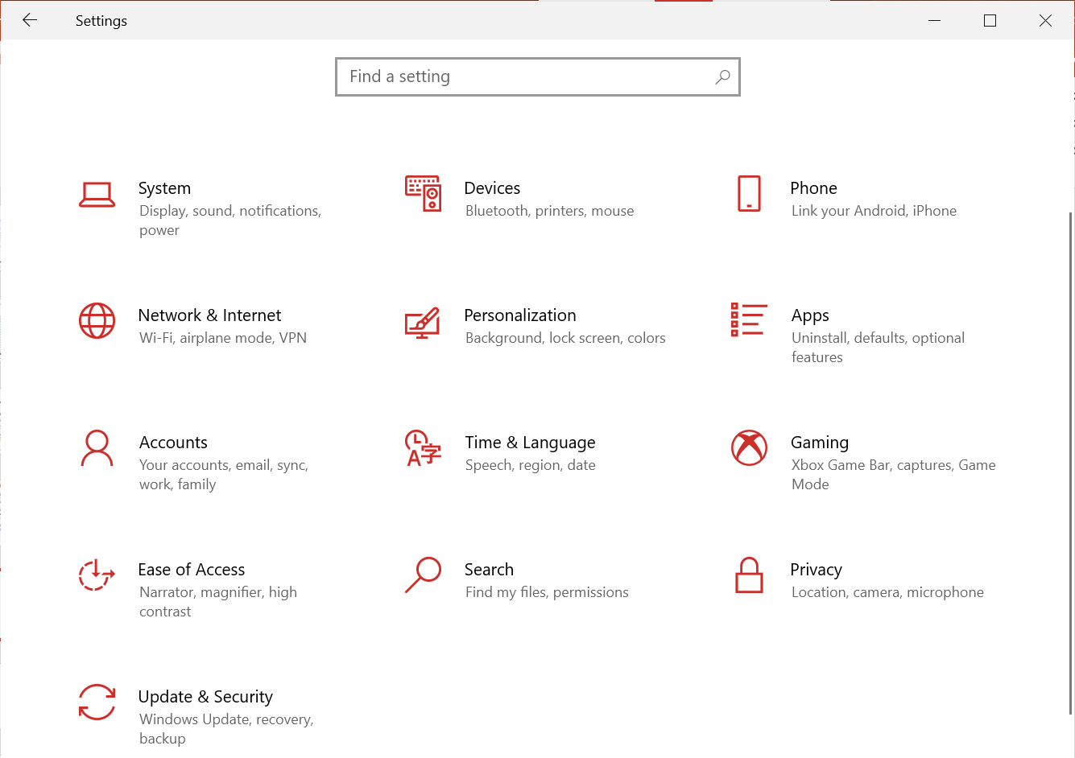
Settings
Department of Computer Science, KNUST-
Kumasi

Slide 64
Setting Date and Time
Your Computer has an internal clock that keeps track of the date and time and is normally displayed at the bottom left of the taskbar.
To change the time and date:
Open Settings by typing it in the search button (Cortana) on the taskbar.
Click on Time & Language, then stay on the Time & Date page
Ensure that the Set time automatically is unchecked.
Now, Click on Change under set time and date manually.
Use the drop down box to set the time and date in the pop-up box, and click Change to apply the change.
If necessary, click the Time Zone tab and use the drop down box to change the time zone.
Department of Computer Science, KNUST-
Kumasi

Slide 65
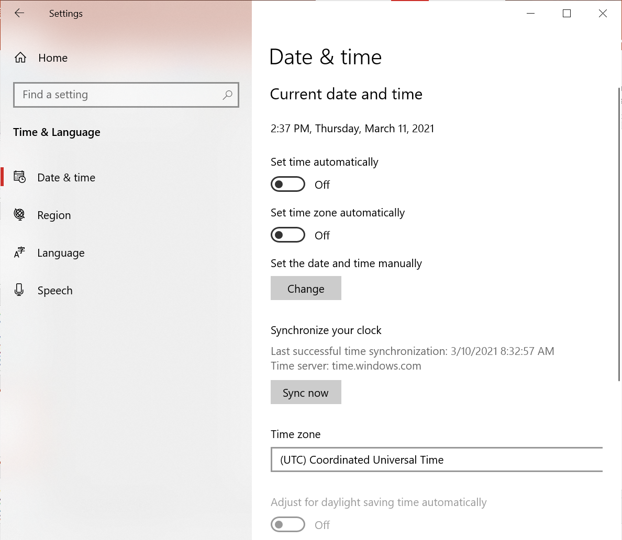
Department of Computer Science, KNUST-
Kumasi

Slide 66
Alternatively
Right-click the time in the far right on the taskbar.
Choose Adjust Date/Time.
The Date and Time Properties dialog box opens.
Use the drop down box to set the month and year.
Click the correct date on the calendar.
Click and select the current time to make a change.
If necessary, click the Time Zone tab and use the drop down box to change the time zone.
Click OK to close the dialog box.
Department of Computer Science, KNUST-
Kumasi

Slide 67
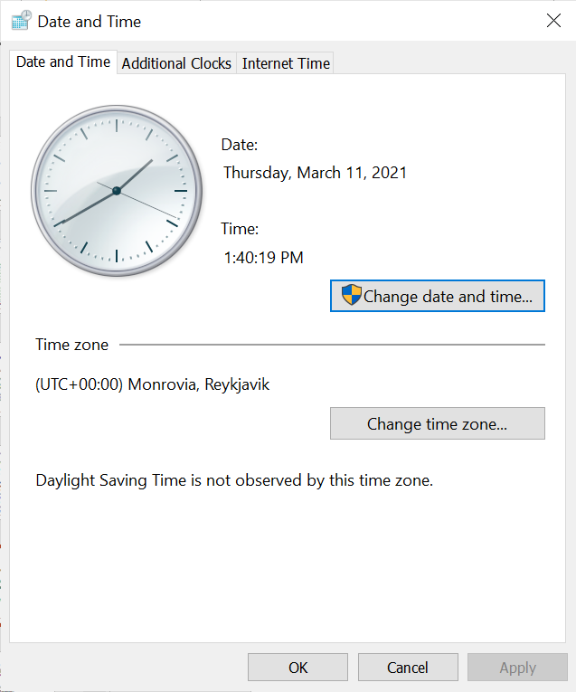
Date and Time
Dialog Box
Department of Computer Science, KNUST-
Kumasi

Slide 68
Changing the Wallpaper
Wallpaper is the background image that appears on your desktop. Windows 10 offers some wallpaper choices that you can select from, if you don’t like your current wallpaper.
To change the wallpaper,
Right-click on an empty space on the desktop and select Personalize.
Under background, select the Type of Background you want (Solid color, Picture or Slideshow).
For Solid Color, you can select the preferred color below the background
Afterwards, click on browse to select the picture (for picture) or the folder which contains the pictures you want for the slideshow (for slideshow).
Department of Computer Science, KNUST-
Kumasi

Slide 69
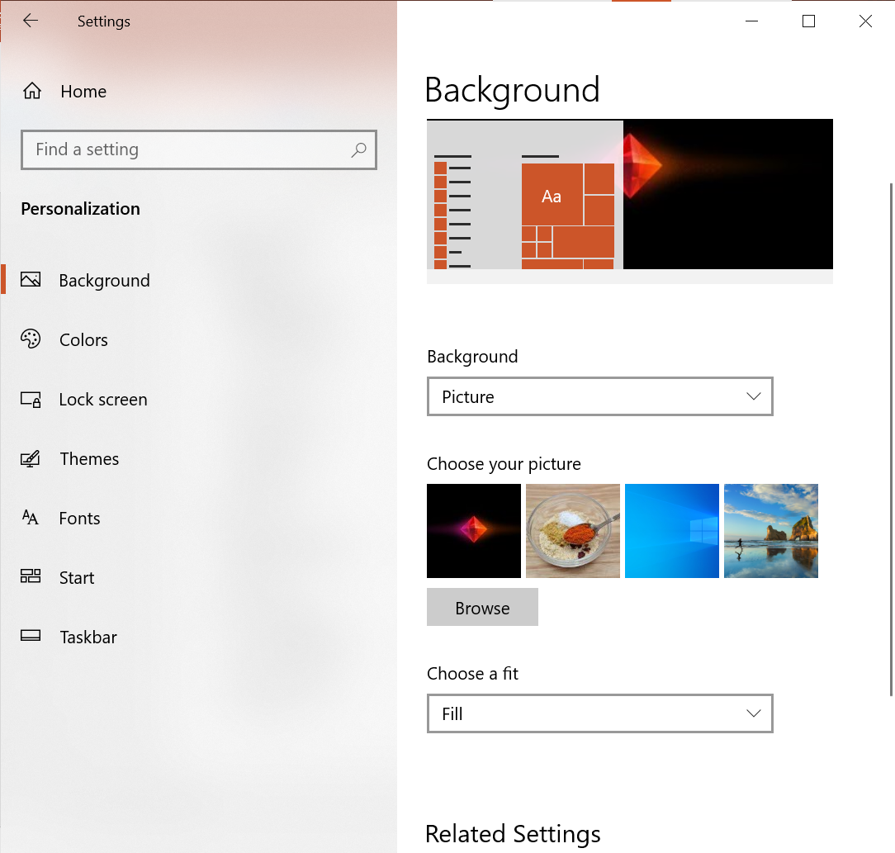
Alternative
Open Settings by typing it in the search button (Cortana) on the taskbar.
Select Personalization
Continue from step 2 of the first approach.
Department of Computer Science, KNUST-
Kumasi

Slide 70
Taskbar and Start Menu Settings
The Taskbar and Start menu have a default configurations or appearance; however, you can customize them to appear the way you want.
To access Taskbar Settings,
Right-click on the Taskbar and select Taskbar settings.
The options to change the appearance of the taskbar are listed there.
To access Start Menu Settings:
Open Settings, click on Personalization and then Start (on the left pane) OR
Use the step of accessing Taskbar settings and click on Start on the left pane.
Department of Computer Science, KNUST-
Kumasi

Slide 71
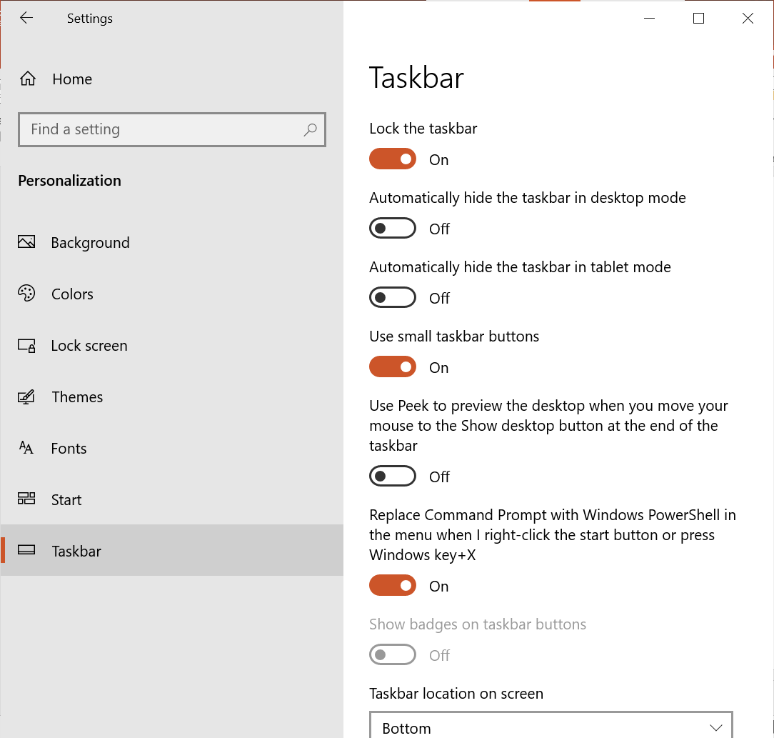
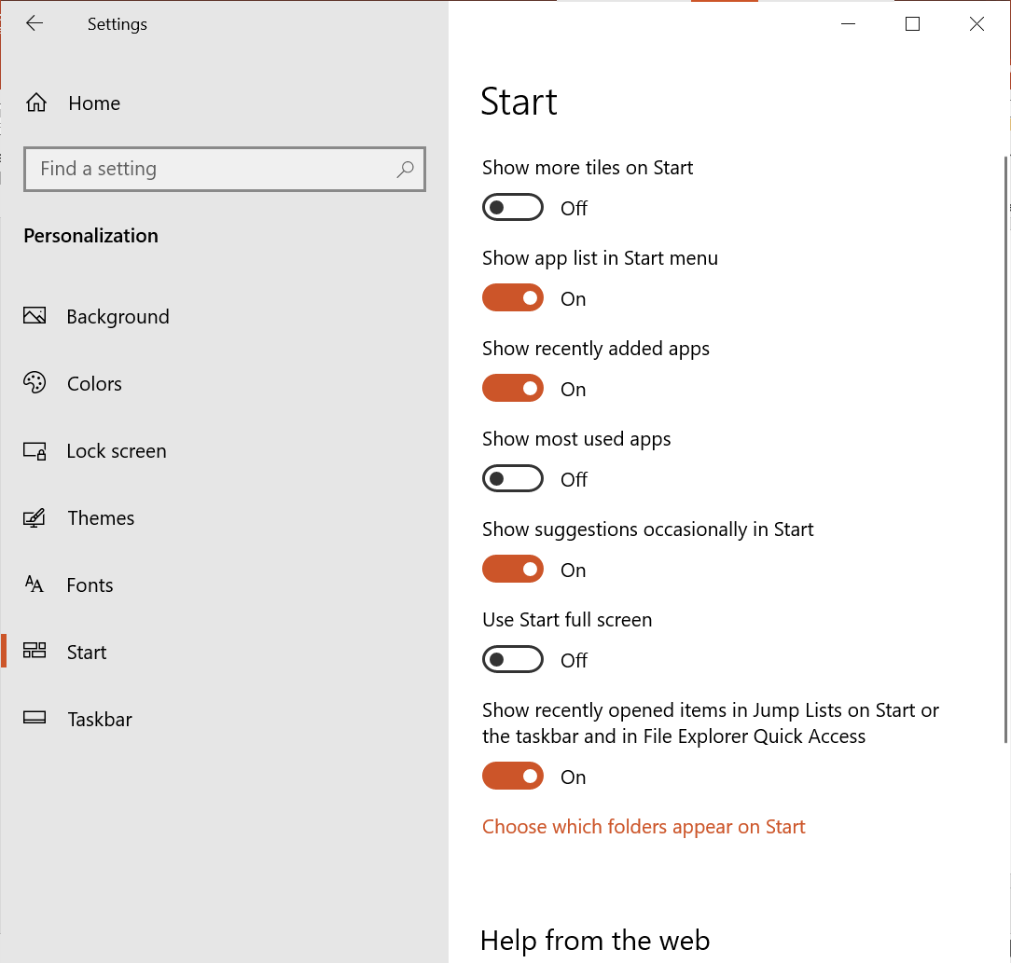
Taskbar Settings
Start Settings
Department of Computer Science, KNUST-
Kumasi

Slide 72
File Management
Files are collections of related information stored on a computer.
There are many different types of files, including
operating system files,
program files, and
your personal files.
Different types of files store different types of information. Each file is given a filename and has a three or four-letter file extension that identifies the file type. (The filename and filename extension are separated by a period.)
For example, a document created using Microsoft Word might have the file name, CSM183 Notes.doc.
Department of Computer Science, KNUST-
Kumasi

Slide 73
File Extensions
File Extension is what defines the file type. Likewise, when a file’s extension is changed just by renaming, the file can get corrupted.
Some of the common file extensions are as follows:
doc/docx: MS Word or WordPad document.
docx: for MS Word 2007 and above.
txt: text file example document created with Notepad or saved as a plain text file by MS Word or WordPad.
eml: Email file
xls: Excel spreadsheet or xlsx (Excel 2007)
htm / html: HTML file (web page)
ppt: PowerPoint presentation or pptx (power point 2007)
mbd: Access database
Department of Computer Science, KNUST-
Kumasi

Slide 74
Creating, Renaming, and Deleting Files
Creating a File
Normally you must give meaningful names to your files so that by just the name you can easily tell what the file is all about.
Files are usually created using the Application that can execute it, however, that is not the case for every file.
For instance, an HTML file is created with a text editor (e.g. notepad) and viewed with a web browser (e.g. Chrome).
In Windows 10, you can create an empty file of some extensions using the steps below,
Right-click on an empty space and click on New
Select the type of file you want to create.
Type the filename you want to give to the file.
NB: With this approach, the file is automatically saved to the folder you are working in.
Department of Computer Science, KNUST-
Kumasi

Slide 75
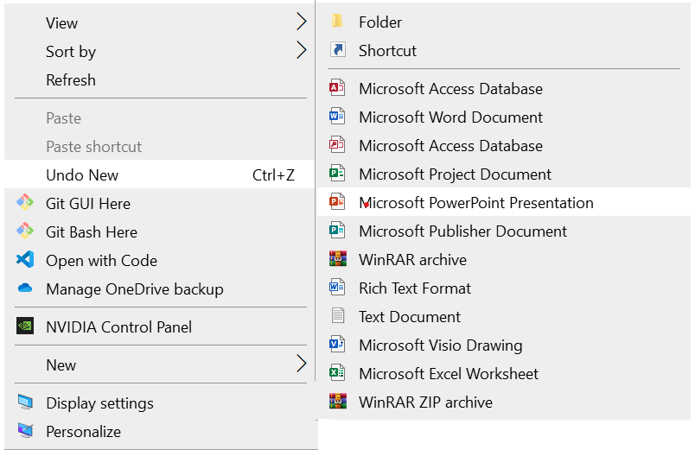
This approach can be used to create a Folder
Department of Computer Science, KNUST-
Kumasi

Slide 76
Creating, Renaming, and Deleting Files
Creating a File
Another approach is creating a file using notepad. The steps involved are as follows;
Click on Start and type notepad, then open it.
Type the file’s content
Click on File at the menu bar and select Save.
OR Press CTRL + S to save.
Browse to the folder you want the file to be.
In the Save as Type drop down box, select the file extension you want and type the preferred filename, OR
Select all and type the preferred filename with the desired extension (separated by a period .)
Department of Computer Science, KNUST-
Kumasi

Slide 77
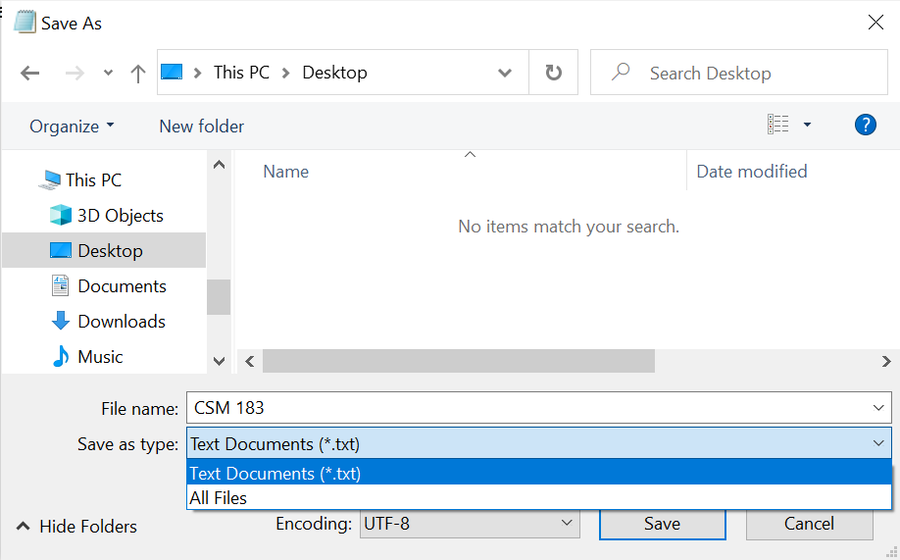
Creating a file using Notepad
Department of Computer Science, KNUST-
Kumasi

Slide 78
Creating, Renaming, and Deleting Files
Renaming a File
To rename a file means to change it’s filename and give it a new filename.
Once you have created a file, you can rename it if you think that the current file name does not help you to easily identify what the file is all about.
To rename a file,
Locate your file (e.g. on desktop)
Right-click the file icon.
Choose Rename.
The filename is highlighted in blue, ready to be retyped.
Type a new name and press Enter.
The file is renamed.
Department of Computer Science, KNUST-
Kumasi

Slide 79
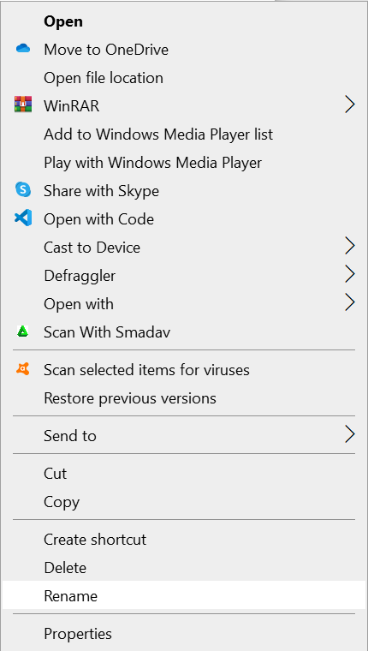
Pop-up options upon Right-clicking a File
Department of Computer Science, KNUST-
Kumasi

Slide 80
Creating, Renaming, and Deleting Files
Alternative Approach
Locate the file
Click slowly on the filename twice (not the file icon)
The current file name will be selected. It will be in a white rectangle and the filename in a blue background.
Use the cursor keys to move around to effect the change or simply type the new name.
Click anywhere outside the file name rectangle box when done.
Department of Computer Science, KNUST-
Kumasi

Slide 81
Creating, Renaming, and Deleting Files
To Delete a File:
Locate your file.
Right-click the file icon and select Delete.
The file is moved to the Recycle Bin.
OR
Locate the file and click on the file icon to select it.
Press Delete (Del) on the keyboard to delete the file.
NB: When a folder is deleted its content; files and sub-folders are also deleted
Department of Computer Science, KNUST-
Kumasi

Slide 82
Creating, Renaming, and Deleting Files
To Permanently Delete a File:
Locate the file, and click on the file icon to select it.
Press Shift + Delete (Del) on the keyboard to delete the file.
A Confirm File Delete dialog box appears asking you “Are you sure you want to permanently delete this file”.
Click on Yes
NB: Permanently deleted files or folders does not go to the recycle bin.
Department of Computer Science, KNUST-
Kumasi

Slide 83
Folders
A folder is just like a file cabinet. When you create many files its difficult at times to find a file as you have to scan through all the files. To keep your files organized, create need to create folders to group them under a preferred filename .
Windows 10 uses various folders to store and manage files by serving as their containers.
Each folder is then used to keep files that are related so that you can find the file within a short time as there may not be too many files in that folder.
Department of Computer Science, KNUST-
Kumasi

Slide 84
To open and view the contents of a file:
Locate the file whose content you need to view. Double-click on the name of the file to view
The application program that was used to create the file will first run and then the document/file to be viewed is loaded into memory for you to view.
OR Right-click on the file name after you have located it and click on Open
OR Locate the file, click the name of the file once and then hit the enter key to open it.
Department of Computer Science, KNUST-
Kumasi

Slide 85
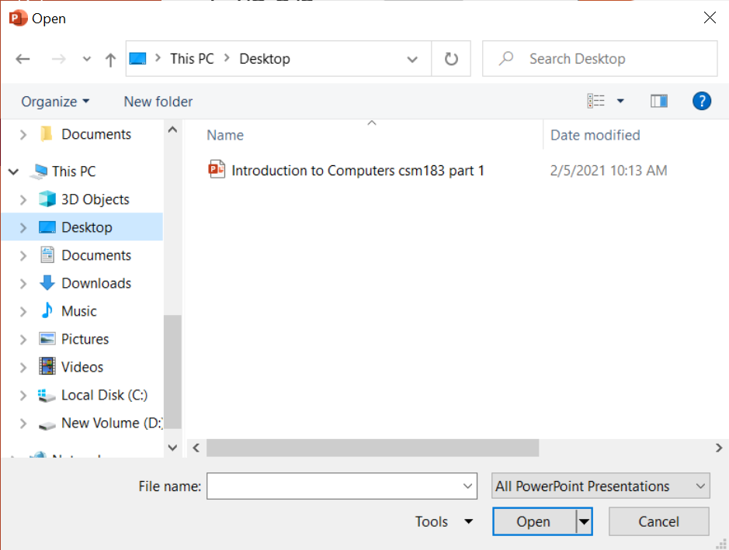
Alternatively, you may
Run the application program used to create the file
Go to File on the menu bar.
Select Open
locate the file
click the file name
and then click Open.
Department of Computer Science, KNUST-
Kumasi

Slide 86
Creating, Renaming, and Deleting Folders
Creating a new Folder
At some point, you may want to create a folder within a folder or create a folder on the desktop. A folder within a folder is called a sub-folder of the parent folder, where parent means the one containing the other folder. To create a new Folder:
Locate where you want to create the folder
Click on the Home tab on the menu bar.
Locate New Folder in the New ribbon
Type the meaningful name you want to give to it. (By default “New Folder” will be the folder name).
Press the Enter key or click on an empty space to create the folder.
Department of Computer Science, KNUST-
Kumasi

Slide 87
Creating, Renaming, and Deleting Folders
Alternatively
Just like creating an empty file;
Locate where the folder is to be created.
Right-click on a blank area
Select New, and click on Folder in the menu that appears.
A new folder icon appears with its default name “New Folder” highlighted in blue
Rename it by typing the name you want to give to it.
.
Department of Computer Science, KNUST-
Kumasi

Slide 88
Creating, Renaming, and Deleting Folders
To Rename a Folder:
Locate your folder.
Right-click the folder icon and select Rename.
The folder name is highlighted in blue, ready to be retyped.
Type the new name and press Enter.
OR
Locate the folder
Click at the folder once
Click at the name of the folder, this will select the current folder name to enable you type in the new name
Type a new meaningful name
(Just like renaming a file)
Department of Computer Science, KNUST-
Kumasi

Slide 89
Creating, Renaming, and Deleting Folders
To Delete a Folder:
Locate your folder.
Right-click the folder icon and select Delete.
The folder is moved to the Recycle Bin.
OR
Locate the folder and click on the folder icon to select it.
Press Delete (Del) on the keyboard to delete the folder.
NB: When a folder is deleted its content; files and sub-folders are also deleted
Department of Computer Science, KNUST-
Kumasi

Slide 90
Creating, Renaming, and Deleting Folders
To Permanently Delete a Folder:
Locate the folder and click on the folder icon to select it.
Press Shift + Delete (Del) on the keyboard to delete the folder.
A Confirm Folder Delete dialog box appears asking you “Are you sure you want to permanently delete this folder”.
Click on Yes
NB: Permanently deleted files or folders does not go to the recycle bin.
Department of Computer Science, KNUST-
Kumasi

Slide 91
Drives
A drive, or disk drive, is a hardware device on which you can store files and folders.
Disk drives are assigned a letter.
Your hard drive is known as the (C:) drive.
Your floppy disk drive is known as the (A:) drive letters A: and B if there are two.
If your computer has a CD ROM drive, it is usually called (D:)
If you insert a pen drive into your USB port, it will normally be given a drive letter higher than your CD-ROM drive letter.
Department of Computer Science, KNUST-
Kumasi

Slide 92
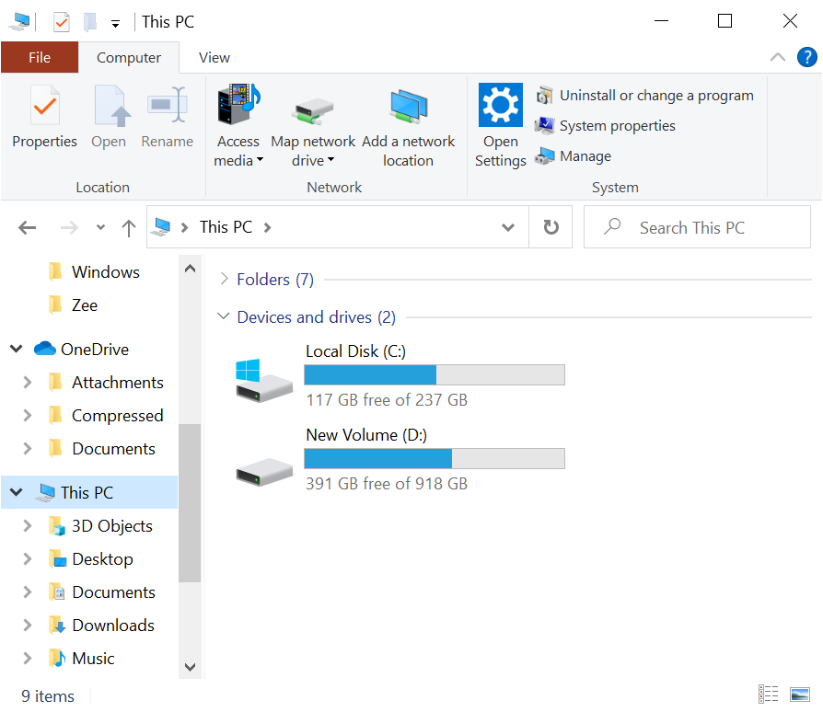
Hard Disk Drive
- Partitions
Department of Computer Science, KNUST-
Kumasi

Slide 93
Exploring My Computer
File Explorer is the main tool you can use to manage files and folders. It is one of the applications pinned to the taskbar by default.
With this tool, you can create, rename and move folders and copy, print, move, delete and rename files. It also allows you to gain access to other system tools.
Unlike the previous versions of Windows that had My Computer, Windows 10 has This PC.
This PC gives a general view of the computer, showing the drives available, inserted some peripherals (like Flash drives etc.) etc.
,
Department of Computer Science, KNUST-
Kumasi

Slide 94
Exploring My Computer – This PC
To launch File Explorer,
First Approach
Click on the file explorer icon on the taskbar to launch it
Second Approach
Press Windows Key + E to launch File Explorer
NB: Every folder is opened by default with File Explorer. Therefore, you can open a folder or This PC on the desktop to launch File Explorer.
Department of Computer Science, KNUST-
Kumasi

Slide 95

Exploring My Computer – This PC
File Explorer Icon
File Explorer Window – This PC
Department of Computer Science, KNUST-
Kumasi

Slide 96
Copying Files and Folders
To copy a file or folder,
Locate the file or folder you want to copy in the required folder or its subfolders.
Click the file or folder you want to copy. The File or Folder highlighted in blue when you select it.
Under Home Tab and Clipboard ribbon, click Copy.
Department of Computer Science, KNUST-
Kumasi

Slide 97
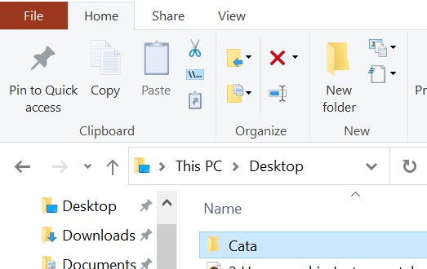
Copying Files and Folders
Department of Computer Science, KNUST-
Kumasi

Slide 98
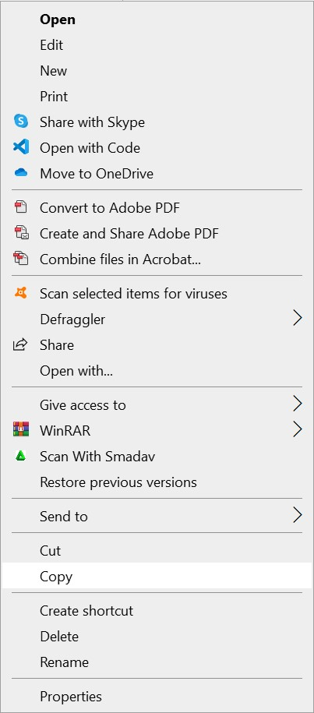
Copying a File/Folder
Locate the file or folder you want to copy and click on it to select it.
Copy the file or folder by,
Press Ctrl + C to copy
OR
Right-click on it and select Copy
Department of Computer Science, KNUST-
Kumasi

Slide 99
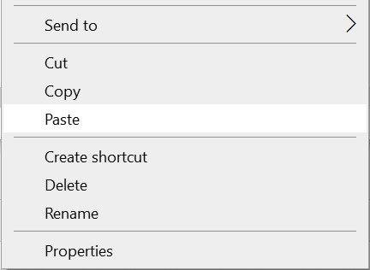
Pasting a File/Folder
After copying,
Go to the folder you want to paste the file or folder
Paste the file/folder by,
Right-click on an empty space and click on Paste. OR
Under Home Tab and Clipboard ribbon, click Paste.
OR
Press Ctrl + V to paste it.
Department of Computer Science, KNUST-
Kumasi

Slide 100
Alternatively,
To copy a file from one folder (source) to another (destination) you can open and juxtapose the two folders.
You can then click at the file to be moved from the source folder, hold down the left button of the mouse and drag the file to the destination folder.
Then release the mouse button when done.
Department of Computer Science, KNUST-
Kumasi

Slide 101
Moving Files and Folders
The difference between copying a file and moving a file is that while the copy makes a duplicate copy of the original file to the new location, the move on the other hand remove the file from its present location and send it to its new location.
Department of Computer Science, KNUST-
Kumasi

Slide 102
To move files and folders:
Locate the file or folder you want to move in the required folder or its subfolders.
Click the file or folder you want to move. The file or folder when you select it.
Under Home Tab and Organize ribbon, click Move to.
In the drop down menu,
Select the place where you move the file or folder in the list that appears.
OR
Select Choose location, and browse to where you want to move the item to and click on Move.
Department of Computer Science, KNUST-
Kumasi

Slide 103
Using the Cut & Paste Approach
Cut Items:
Locate and select the file/folder.
To cut the file/folder,
Press on Ctrl + X OR
Right-click the file/folder, and select Cut. OR
Click on Cut (Scissors icon) in the Clipboard ribbon in the Home Tab
Paste Items:
Locate the folder you want to move/paste to:
Right-click on the folder and click on Paste. OR
Open the Folder and Press Ctrl + V
Department of Computer Science, KNUST-
Kumasi

Slide 104
Cut
Icon
Cutting a File/Folder using the Menu bar
Department of Computer Science, KNUST-
Kumasi

Slide 105
Selecting More Than One File or Folder
More often than not, you may need to copy or move multiple files and folders at the same time. To do so, Hold down
the Ctrl key (if the files and the folders are scattered) OR
the Shift key (if the files and folders follow one another)
and click to select the files or folders you want to move or copy.
For the shift key, just click on the first file, hold down the Shift key and then click the last file and all those between them will be selected as well.
NB: The files or folders are highlighted in blue as they are selected.
Copy or move the file or folder using one of the methods explained on the previous pages.
Department of Computer Science, KNUST-
Kumasi

Slide 106
Choosing View
You can display them as Thumbnails, Tiles, large icons, small icons, as a list, or as a list (Details) with details including size, type and date last modified.
To choose View in File Explorer,
Open the required folder
Go to the Layout ribbon in the View Tab on the menu bar.
Click on more to open a drop down menu of views. Hover over the views to see their effect.
Click on the view to set it as current view
A large black dot appears next to your current choice. OR
Right-click on a blank space, click on Views and select the view you want
Department of Computer Science, KNUST-
Kumasi

Slide 107
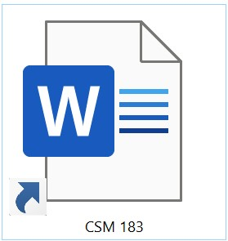
Shortcut
A shortcut offers the best way of doing a task more quickly such as starting a program or accessing a document.
The shortcut icon has a small arrow in the left corner to help you distinguish it from the actual icon that represents programs and files.
Deleting a shortcut does not affect the original item the shortcut points to.
Department of Computer Science, KNUST-
Kumasi

Slide 108
Creating a Shortcut
There are a number of ways by which one can create shortcuts for files and programs. Below are some of the commonly used methods.
Creating a shortcut to the desktop using Windows Explorer or This PC:
Open File Explorer or This PC.
Browse to the location of the item you want .
Right-click on the file, program, or folder for which you want to make a shortcut
Click on Send to, and click on Desktop (Create Shortcut)
Department of Computer Science, KNUST-
Kumasi

Slide 109
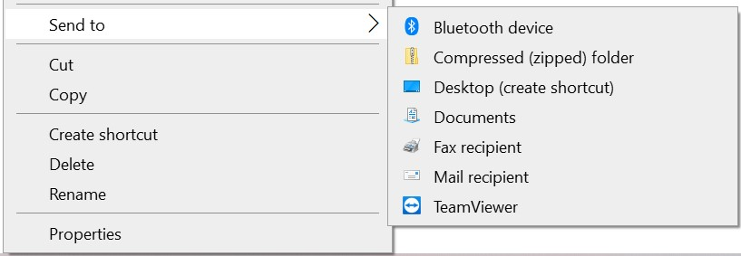
Creating a Shortcut
Creating a shortcut to the desktop
Department of Computer Science, KNUST-
Kumasi

Slide 110
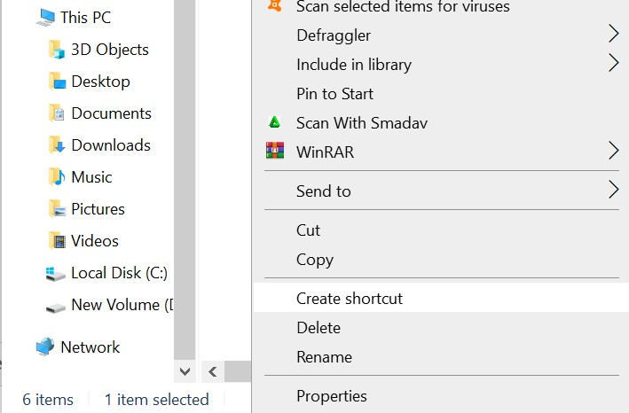
Right-clicking to Add a Shortcut
The quickest way of creating a shortcut requires a right-click. To add a shortcut by right-clicking:
Open File Explorer or This PC, Locate the file/folder for which you want to make a shortcut
Click on Create Shortcut. Resize the window to see the desktop
Drag the shortcut icon to the desktop
(you can drag to the desktop in the left pane)
Desktop on the left pane
Department of Computer Science, KNUST-
Kumasi

Slide 111
The Recycle Bin
When you delete any file (not permanent delete), the file is kept in the recycle bin.
A file in the recycle bin can be retrieved if the need be.
The Recycle Bin is the desktop icon that resembles a wastebasket.
It is possible to open the Recycle Bin folder anytime and see what's inside by double-clicking the Recycle Bin icon located on the desktop or using File Explorer.
You can delete an item by moving it to the Recycle Bin. The items can be moved from anywhere.
Department of Computer Science, KNUST-
Kumasi

Slide 112
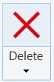
To move an item to the Recycle Bin using File Explorer
Click and drag the file or folder to the Recycle Bin (while the recycle bin can be seen).
OR
Right-click the file/folder you want to delete, and select delete.
OR
Click the file or folder you want to delete.
Under Home tab, click on delete
in the Organize ribbon.
OR
Select the file/folder and press the Delete key
Department of Computer Science, KNUST-
Kumasi

Slide 113
Restoring Files From the Recycle Bin
Though items in the Recycle Bin are "deleted items“, you can still retrieve them at a later date. You can restore either a single file, group of files or all files.
Using the Restore all items command (located in the Recycle Bin Tool tab) will move all files and folders in the Recycle bin back to their original locations on your computer.
To restore all items in the Recycle Bin,
Click the Restore all items command in the Restore ribbon of the Recycle Bin Tool tab.
The items are restored to their original locations.
Department of Computer Science, KNUST-
Kumasi

Slide 114
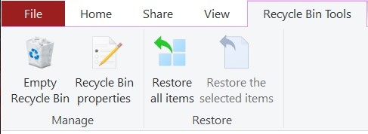
To empty the Recycle Bin
Click the Empty the Recycle Bin command in the Manage ribbon of the Recycle Bin Tool tab.
It is also possible to delete some of the items in the recycle bin.
Note that this will delete the items permanently. To do so, just select the item(s) to be deleted.
Right click the mouse button and then select Delete.
Department of Computer Science, KNUST-
Kumasi

Slide 115

At times, it is possible for one not to remember where an item on his/her computer can be located. This is normally the case when you have too many folders and folders within folders. Windows 10 has a search companion called Cortana that makes it possible to look for files and folders, just by clicking on the search bar on the taskbar. To search, simply type in the Cortana Search Box
Opening the Search Companion
Cortana Search Box
Cortana Button
Department of Computer Science, KNUST-
Kumasi

Slide 116
Search Companion – Cortana
The Search Companion (Cortana) tells you when the search is complete and prompts you with more Search options.
Cortana has a item category search, where you can filter the search to only some item type(e.g. Music)
If the file is found then simply double-click the to open it.
Cortana takes the entire system as it’s scope of search, however, it is quick in its search.
Cortana also makes room for a web search to be conducted.
Department of Computer Science, KNUST-
Kumasi

Slide 117

Cortana Search Categories
Search Results
Search Companion – Cortana
Department of Computer Science, KNUST-
Kumasi

Slide 118
Alternatively, you can search with the Search box in File Explorer.
Key thing with this search is that, the current folder you are in, and its sub-folders, becomes the scope of the search.
The Search tells you when the search is complete and prompts you with more Search options. If the file is found then simply double-click the to open it.
You can also right-click on the file/folder, then click on Open File Location (at the bottom of the drop down menu) to open the Folder that contains the searched item.
No matter the number of files on your computer, finding a file can take seconds, minutes or much, much longer depending on the type of search and where you are looking.
Department of Computer Science, KNUST-
Kumasi

Slide 119

Search Tab
Configure your search here – Item type search, Location or depth search, etc.
Search Box
Department of Computer Science, KNUST-
Kumasi

